Slide 1
DATA SCIENCE on Microsoft Azure
Created by
Mouafek Ayadi
Notes:
https://slidesgo.com/theme/data-science-consulting

Slide 2
What is Data Science?
Computer Science
Business Knowledge
Artificial Intelligence
Mathematics
Software Engineering
Domain Expertise
Machine Learning
Probability & Statistics

Slide 3
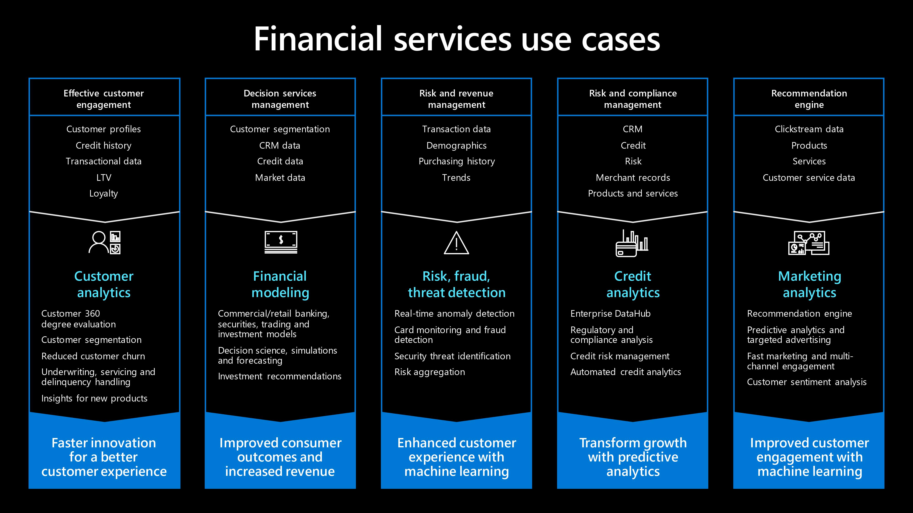

Slide 4


Slide 5
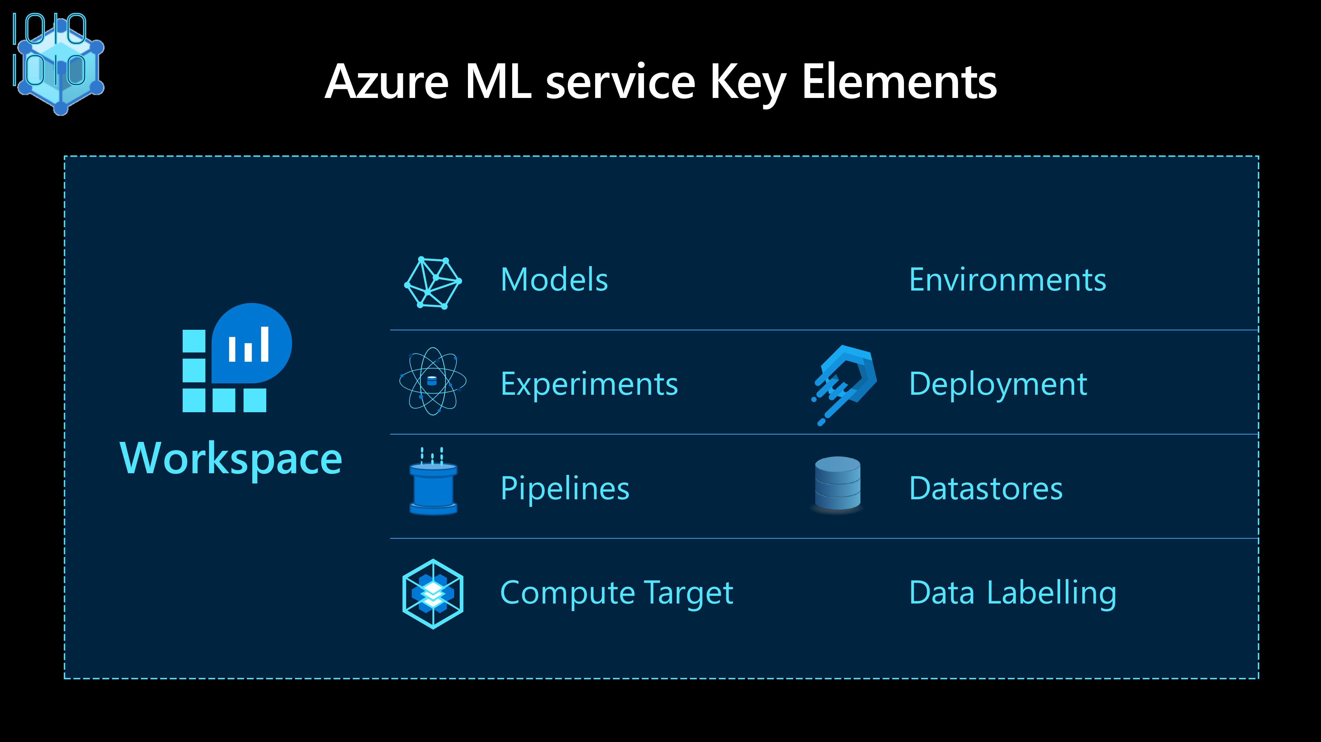

Slide 6
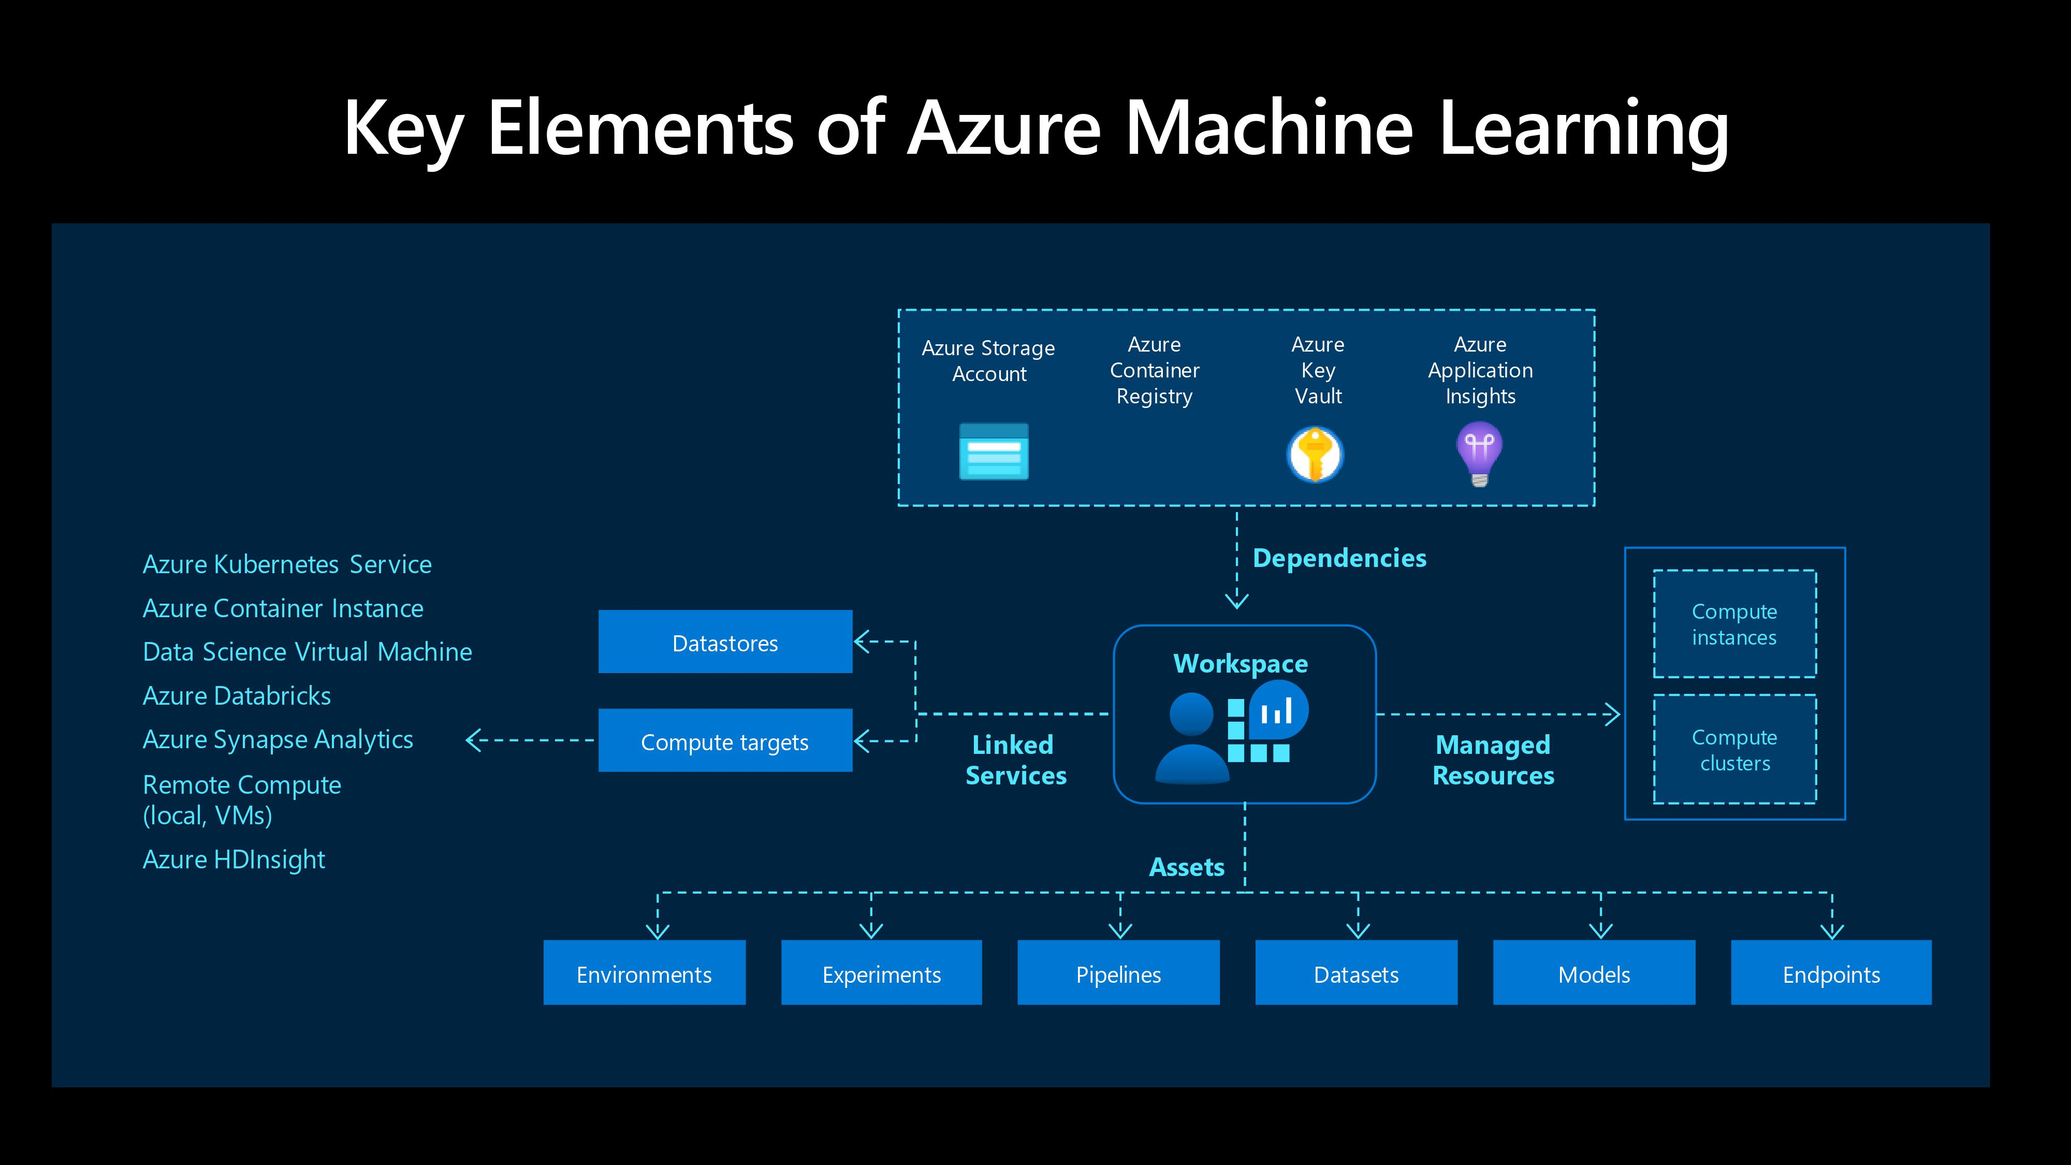

Slide 7
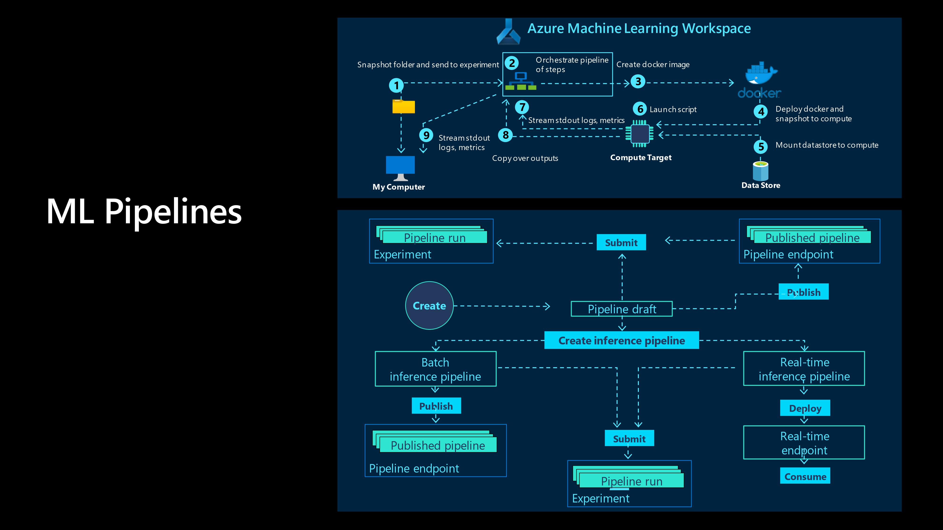

Slide 8
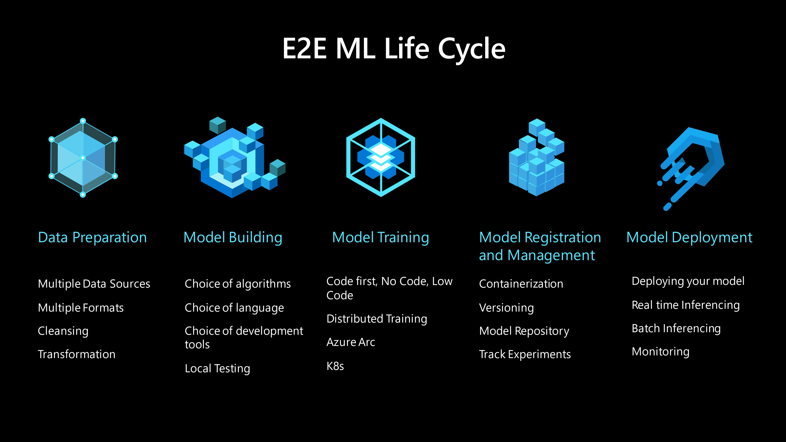

Slide 9
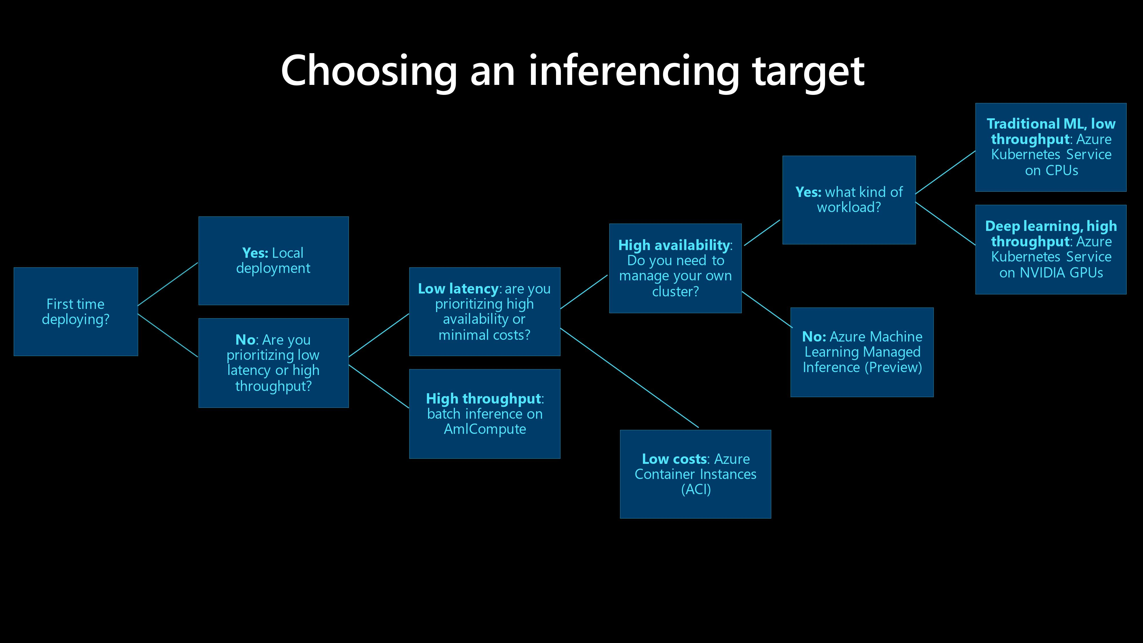

Slide 10
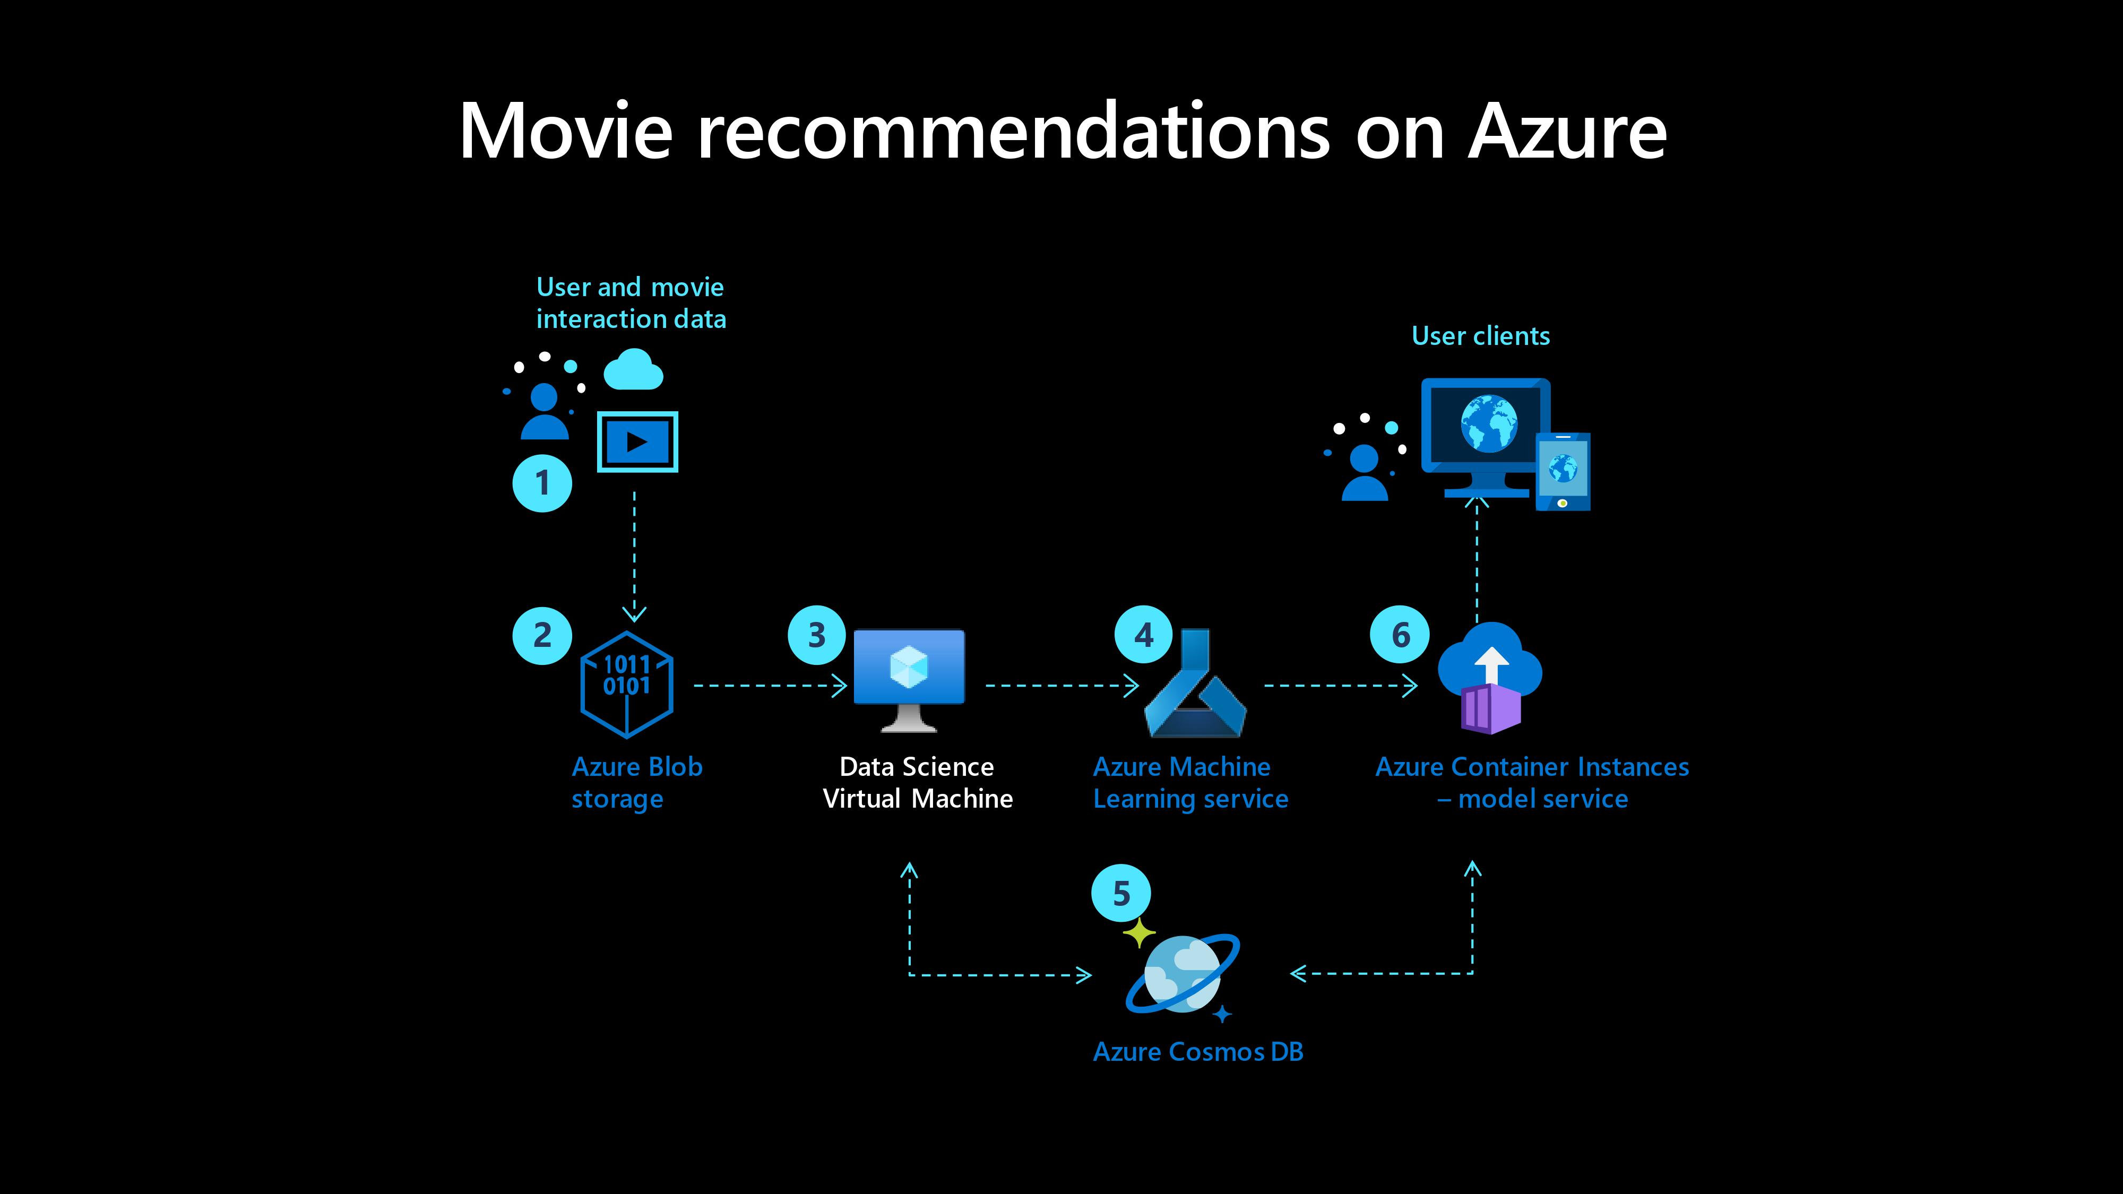

Slide 11
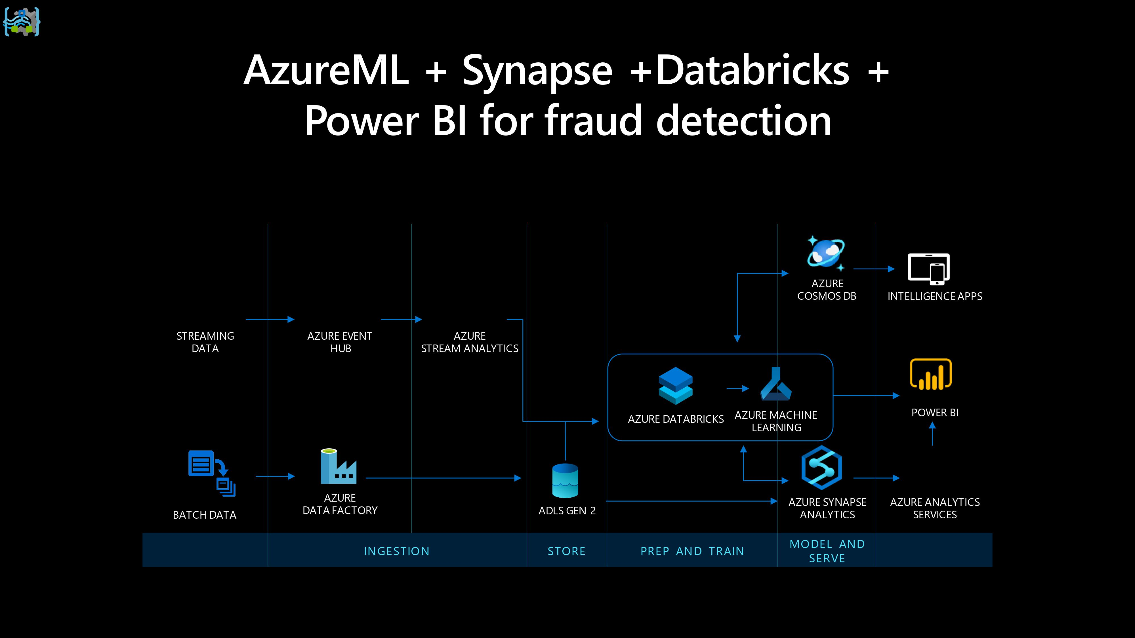

Slide 12
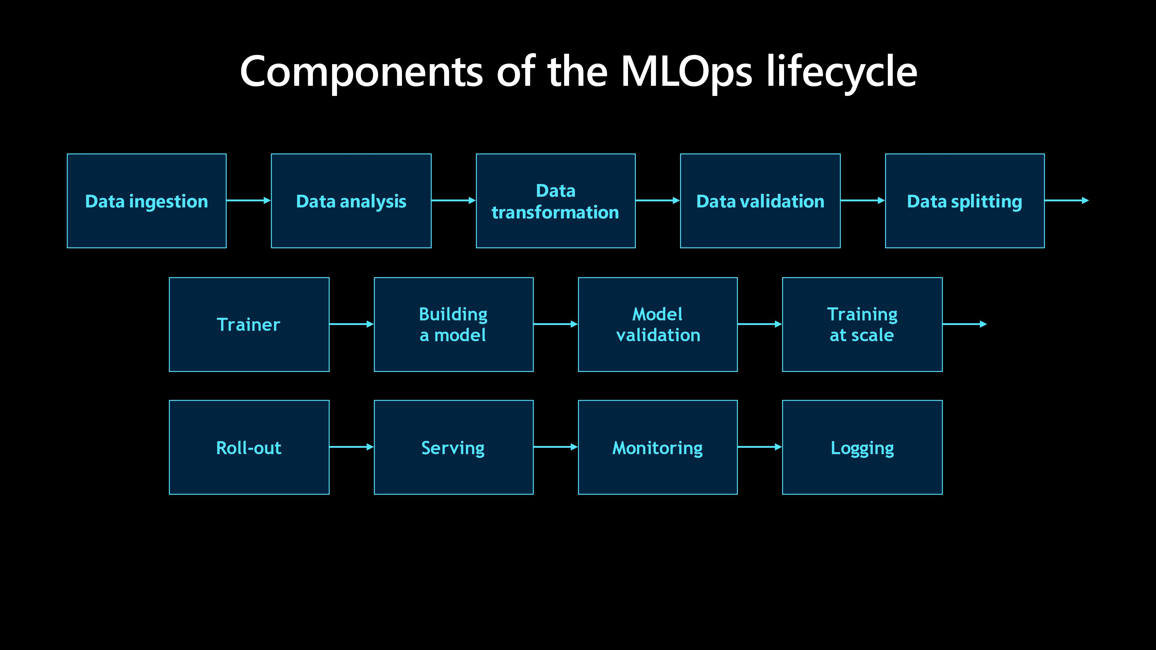

Slide 13
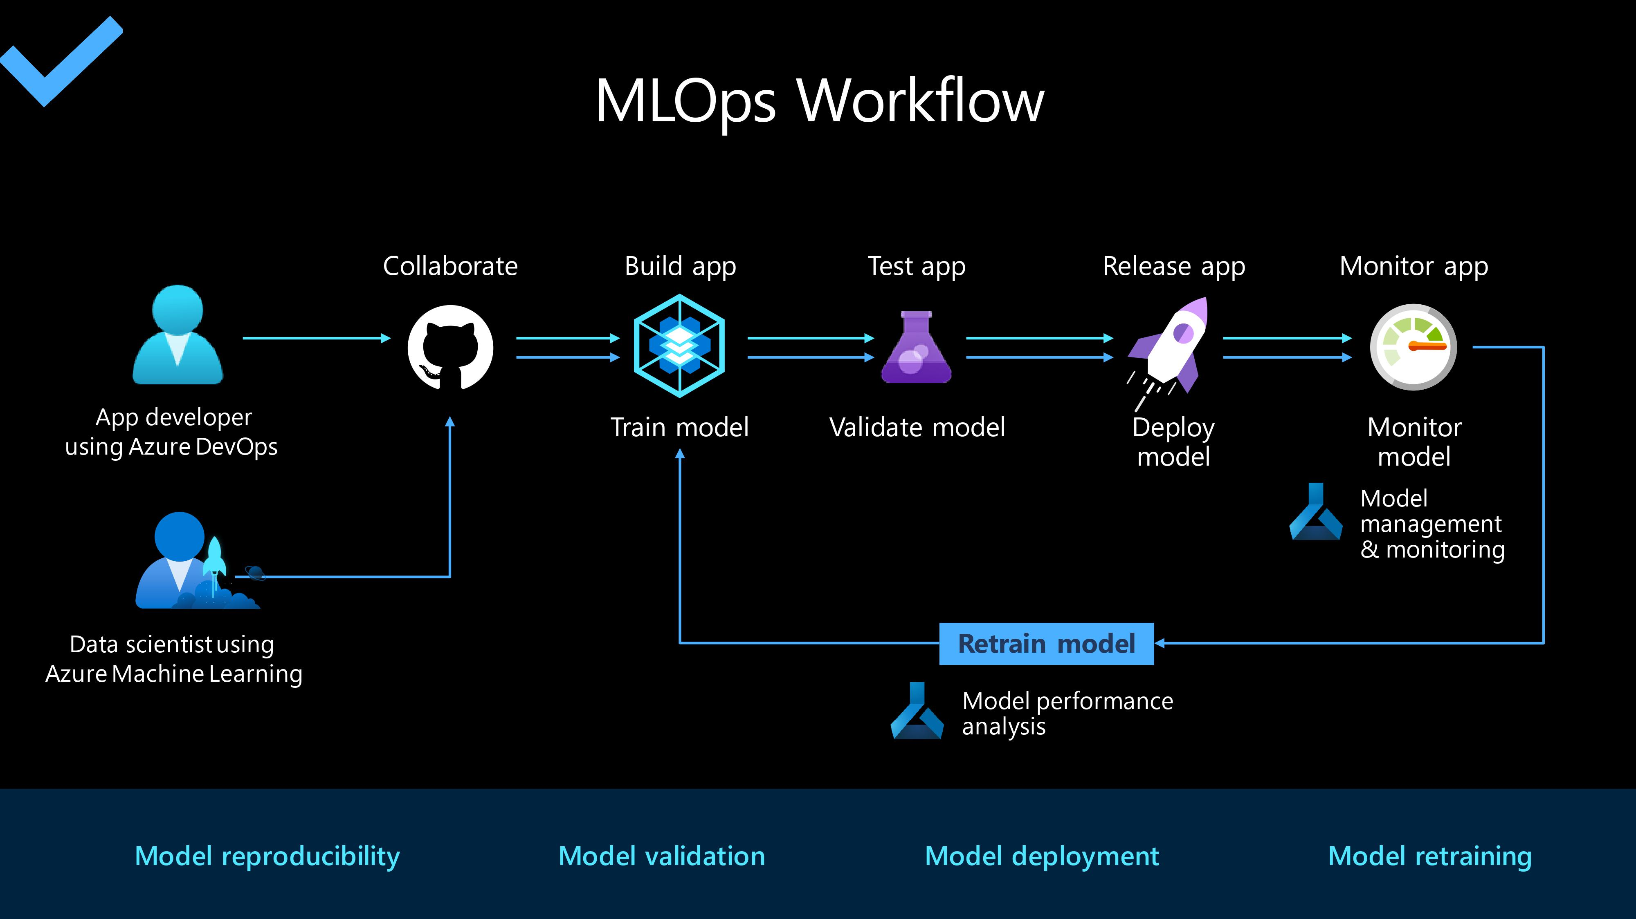

Slide 14
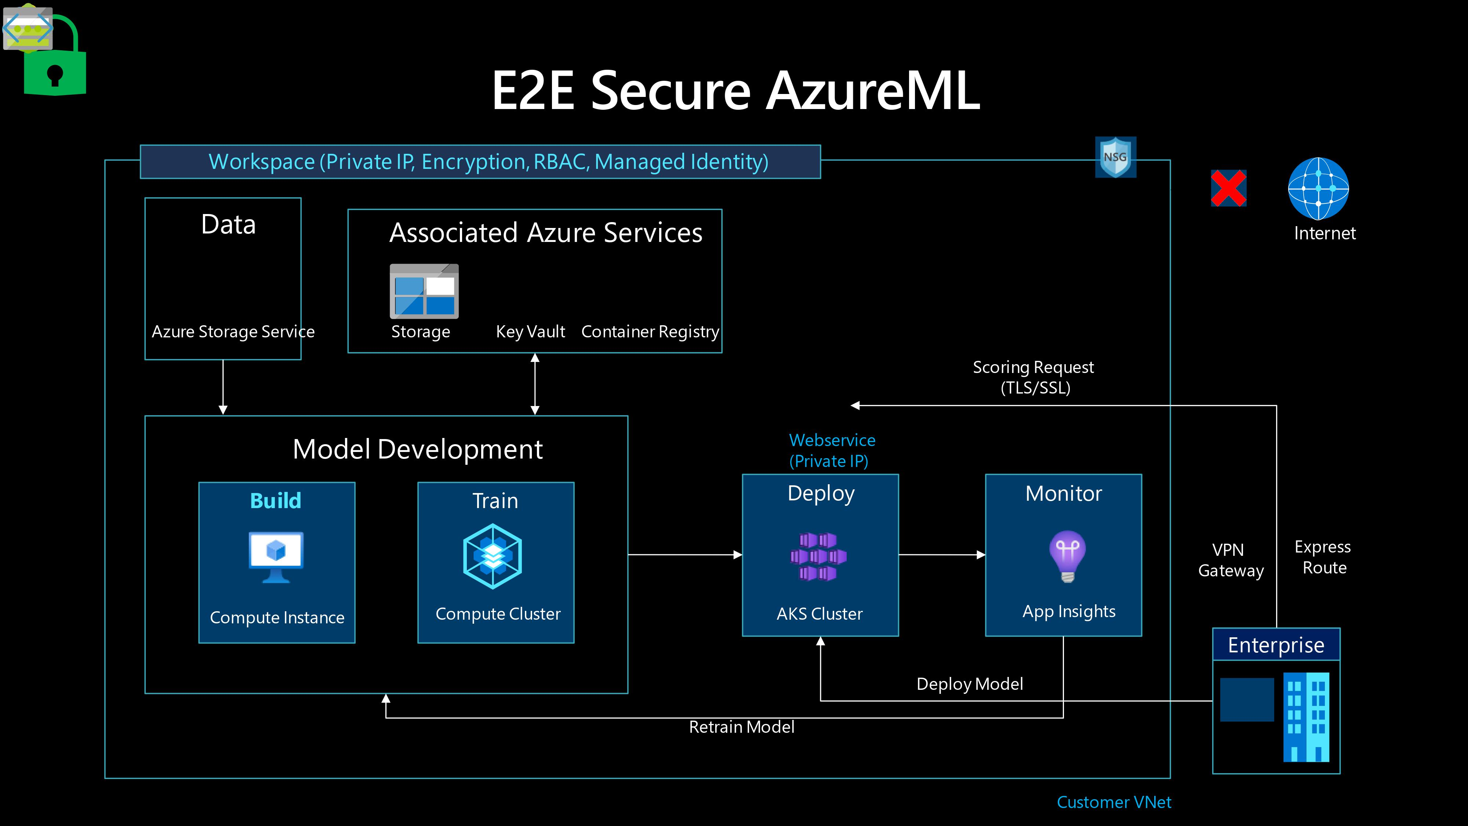

Slide 15
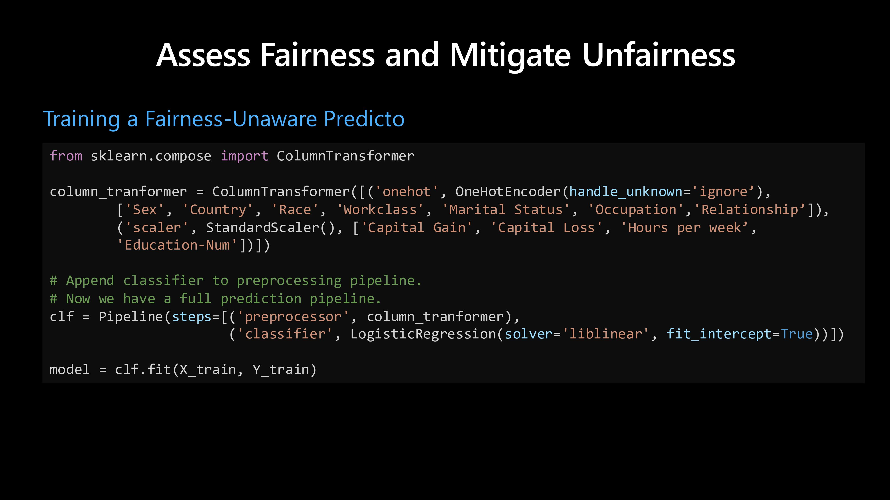

Slide 16
THANKS
Do you have any questions?
https://www.linkedin.com/in/mouafek-ayadi/

